Slide 1
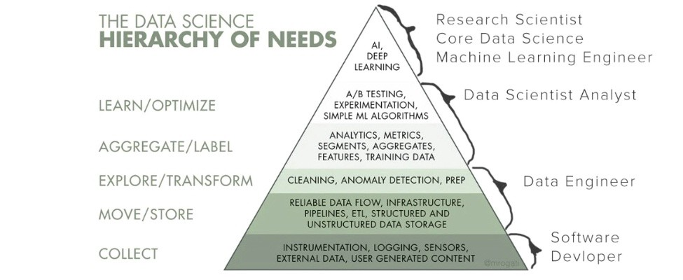
Data Infrastructure Demands
Organizations must build the infrastructure to implement (and reap the benefits of) the most basic data science algorithms and operations, much less machine learning.
Monica Rogatti, 2017

Slide 2
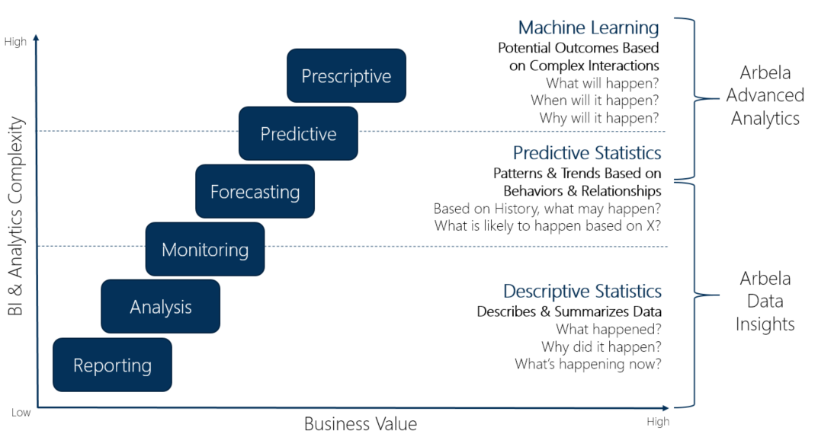
Information Utilization: Where are We?
Capability Progression
Functional but Antiquated Capability
The Information ‘Escalator’
Source: Argano (https://microsoft.argano.com/technologies/dynamics-extensions/argano-data-insights/)

Slide 3

Infrastructure to Capability Relationship
Increase in organizational information capabilities can only occur when a threshold level of infrastructure is achieved and functioning
Data Scientists / Statisticians
Business Intelligence Analysts
BI / Data Analysts
Threshold Level of Infrastructure

